Slide 1

DEPARTMENT OF PHYSICS AND NANOTECHNOLOGY
SRM INSTITUTE OF SCIENCE AND TECHNOLOGY
18PY103J – Physics: Semiconductor Physics
Module-V, Lecture-15
Band diagrams of Heterojunctions
‹#›
18PYB101J Module-V Lecture-15

Slide 2
Semiconductors
Semiconductor material is not of much use in any application.
One of the application where semiconductors are directly used is a photoconductor and not a junction device.
Most of the semiconductor junction devices has conductivity between good and bad conductors.
Conductivity can be modified by doping. But at fabrication stage there is no real time control on conductivity.
Real time control on conductivity could be achieved using p-n junction which forms the basic building block of all active devices in electronics and optoelectronics.
The objective of the present seminar is to study how band diagram of heterojunctions behave in the case of heterostructures.
‹#›
18PYB101J Module-V Lecture-15

Slide 3
p-n junction devices
p-n junction devices are basically used for active control of charge carriers (control of current). p-n junction devices are classified based on process and structure.
p-n junctions are classified in to three types by the process approach. They are:
Diffusion
p-n Ion Implantation
Epitaxial Growth
Diffusion: Fabrication process which starts with a substrate and the required amount of dopant is deposited and diffused in to the substrate (viz., n-substrate). This forms a diffused region if p-material is doped on to the substrate.
Ion Implantation: In the case of ion implantation, ion beams are implanted in to the n-substrate.
Both diffusion and ion implantation leads to the creation of graded junction devices (graded in terms of carrier/dopant concentration).
‹#›
18PYB101J Module-V Lecture-15

Slide 4
Epitaxial growth: It is a process by which a complete layer of p-substrate is grown on the n- substrate. This kind of fabrication leads to the formation of abrupt junction devices.
p-n junction are classified in to three types based on structure.
Homojunction (junction between same material p and n doped)
p-n Heterojunction( junction between dissimilar materials with different band gap)
Schottky junction(junction between metal and a semiconductor, it can act as a rectifying junction or ohmic contact)
When a p-n junction device is made metal layer for contact is needed and hence Schottky ohmic contacts are always present in all devices.
‹#›
18PYB101J Module-V Lecture-15

Slide 5
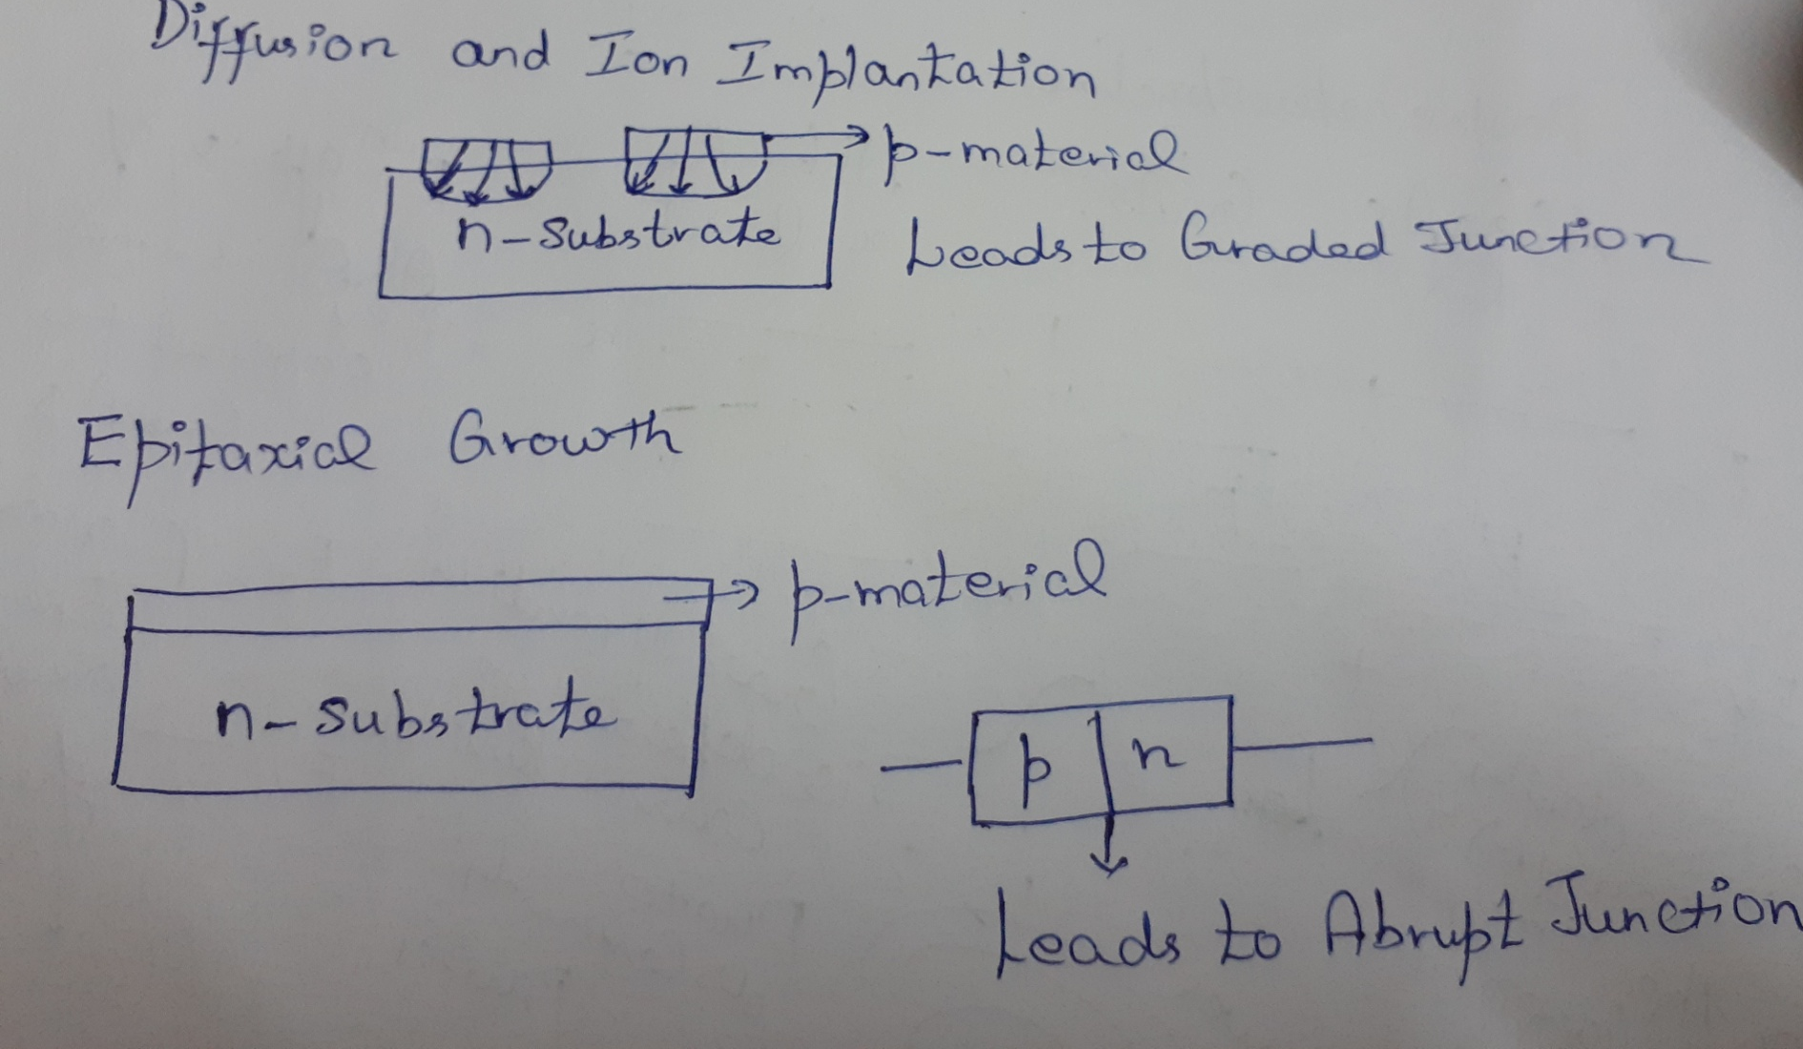
Diffusion, Ion Implantation and Epitaxial Growth
‹#›
18PYB101J Module-V Lecture-15

Slide 6
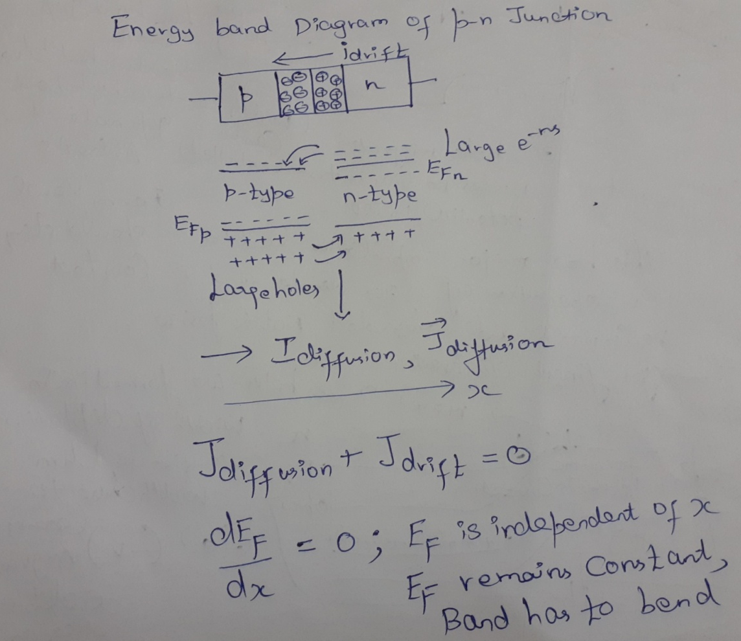
Energy band diagram of p-n junction
When a p-n junction is formed there is a difference in carrier concentration. So, electrons move from the higher concentration n to the lower concentration p.
The movement of electrons and holes in the CB and VB creates +ve immobile ions on the n side and –ve immobile ions on the p side. Due to applied potential difference, there is drift current produced. At equilibrium the magnitude of drift and diffusion current are constant and are opposite in sign.
‹#›
18PYB101J Module-V Lecture-15

Slide 7
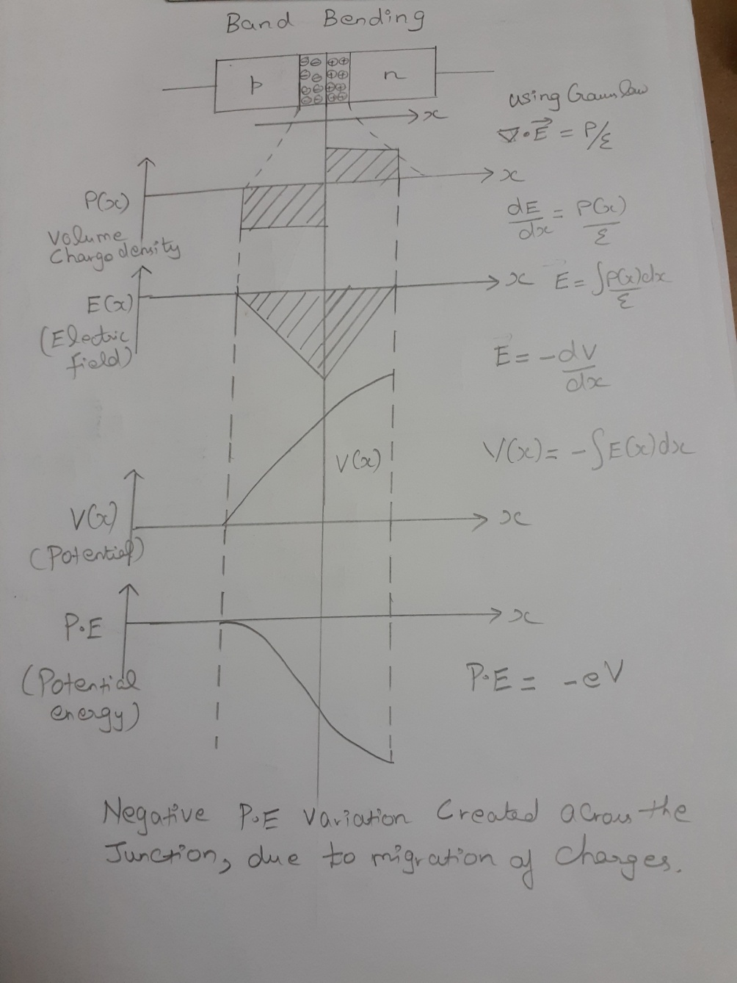
Energy band diagram of p-n junction
ρ(x) –Volume charge density
-ve ρ(x) gives -ve E(x).-ve ρ(x) added to +ve ρ(x), the sum starts to decrease in E(x).
Integrating E(x) with a negative sign gives increasing potential V(x).
Due to charge migration P.E variation occurs across the junction from 0 to some value.
Due to the electrons/ holes migration, there is a built in potential and hence –ve potential energy variation across junction being produced.
‹#›
18PYB101J Module-V Lecture-15

Slide 8
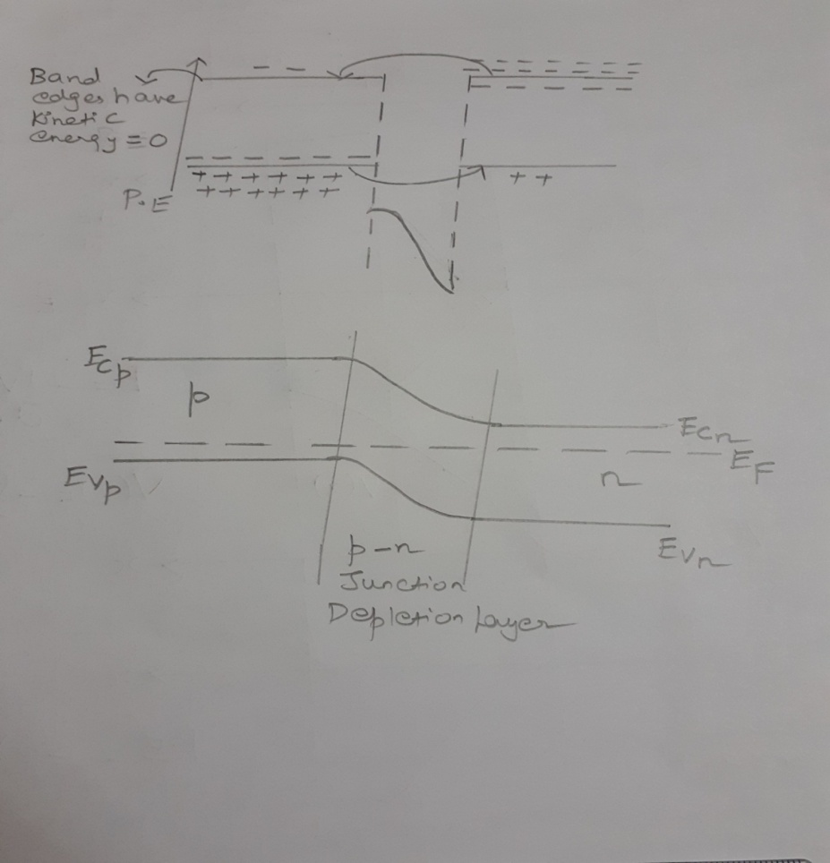
Energy band diagram of p-n junction
The band edges have kinetic energy =0 and hence posses only potential energy.
-ve potential energy variation added together with the gradient of carrier concentration produced due to the diffusion of charge carriers across the junction at zero bias gives a p-n junction band structure as shown in the figure with Fermi level E_{F} remaining the same.
‹#›
18PYB101J Module-V Lecture-15

Slide 9
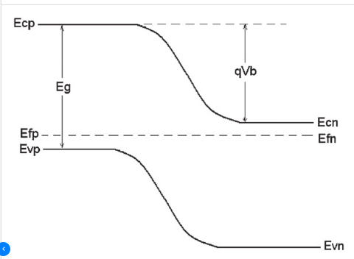
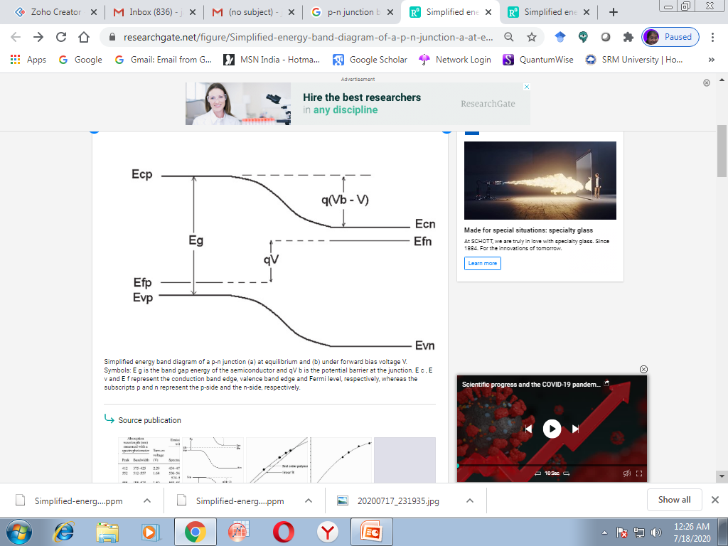
Energy band diagram of p-n junction
(a)
(b)
Simplified energy band diagram of a p-n junction (a) at equilibrium and (b) under forward bias voltage V. Symbols: E g is the band gap energy of the semiconductor and qV b is the potential barrier at the junction. E c , E v and E f represent the conduction band edge, valence band edge and Fermi level, respectively, whereas the subscripts p and n represent the p-side and the n-side, respectively. Built in potential energy qV b is higher at zero bias and reduces at higher bias. Hence the bands become shallow at junction with biasing, thereby enabling more charge carriers to cross the junction reducing the width of depletion region.
‹#›
18PYB101J Module-V Lecture-15

Slide 10
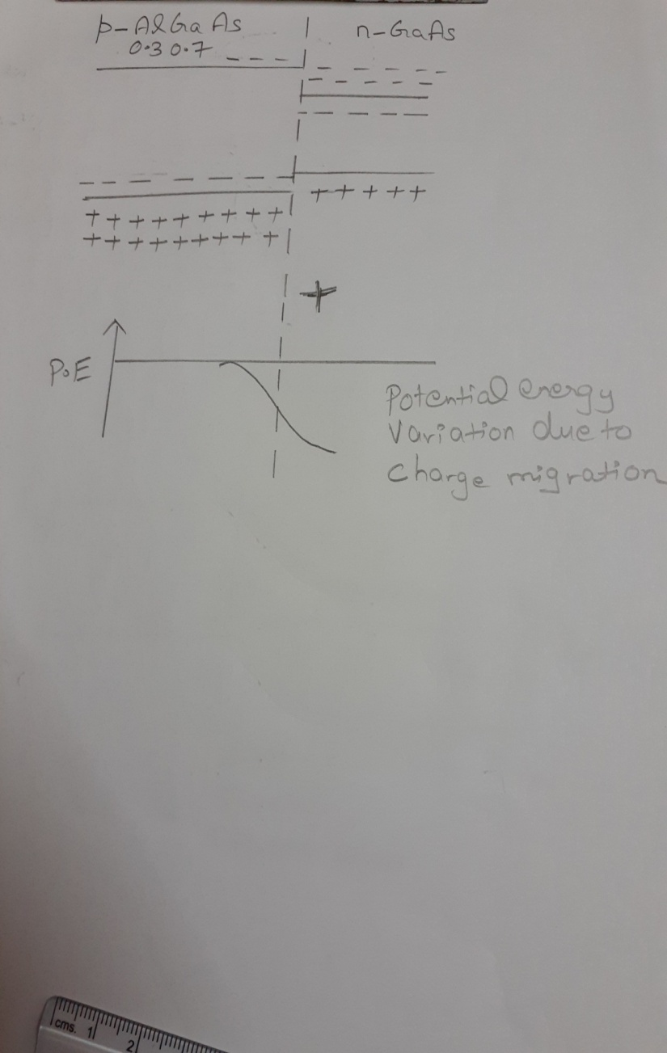
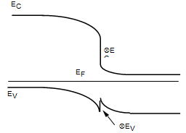
Band diagrams of Heterojunctions
Dissimilar p-n junction materials- Single layer
If intrinsic material of p-AlGaAs and n-GaAs are taken as single layer heterostructure and there is no difference in the carrier concentration then 70% and 35% variations are observed in the band structure. The carrier concentration difference leads to flow of carriers. Therefore P.E variation occurs and hence band structure varies.
Due to electron hole movement –ve immobile electrons are created on the p side and +ve immobile holes are created on the n-side.When the n-GaAs end becomes more +ve than the –ve end, P.E decreases.
E (V_{built in)}
∇E_{C}
∇E_{V}
‹#›
18PYB101J Module-V Lecture-15

Slide 11
Band diagrams of Heterojunctions
Dissimilar p-n junction materials- Single layer
The total P.E variation at the junction would be the P.E variation due to the charge migration plus the band gap variation.
At the junction the built in potential is larger and hence ∇E_{C} have a downward discontinuity and ∇E_{V} have an upward discontinuity. Hence in an heterostructure the net barrier height has become much larger due to large V_{built} .
The potential well confines the flow of carriers. They have profound importance in the characteristics of the device.
‹#›
18PYB101J Module-V Lecture-15

Slide 12
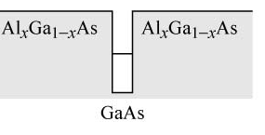
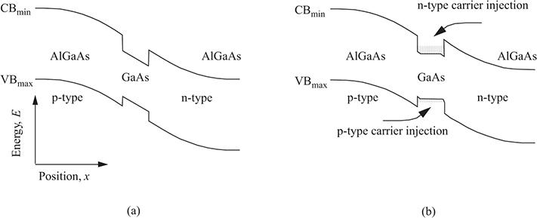
Band diagrams of Heterojunctions
Dissimilar p-n junction materials- Double layer
Consider a double layer heterostructure comprising of AlGaAs(p⁺), GaAs(p) and AlGaAs(n) as p and n regions.
The elctron affinity of AlAs (2.2 eV) is smaller than GaAs(4 eV).The electron affinity is the amount of energy required to free an electron at E_{C.}
GaAs with a lower band gap is sanwiched between two high band gap materials (AlGaAs). Fermi level should stay constant.
(a)
(b)
‹#›
18PYB101J Module-V Lecture-15

Slide 13
Band diagrams of Heterojunctions
Dissimilar p-n junction materials- Double layer
At p⁺ - p band edge region there is a downward discontinuity at the E_{c} and an upward discontinuity at E_{V.} Similarly, at the p-n band edge region, there is a an upward discontinuity at E_{C} and downward discontinuity at the E_{V.}
The migration of electrons and holes under no bias together with the change in the P.E at the junctions and the discontinuity between the layers result in a large potential barrier at the E_{C} of p⁺-p region side. Therefore electrons and holes are confined to the junction(Width of the barrier can be controlled). Carrier density is very high (For the same current, large number of electrons and holes are accumulated in a small volume).This is called carrier confinement. This had a major implication and lead to the continuous wave operation of laser diodes and was recognized as finest discoveries and was awarded Nobel Prize. In short the gain of the medium is dependent on the carrier density.
Whereas, in the case of p-n junction, the width of depletion region is 1 micrometre at zero bias and cant be controlled. For the same current, volume is larger. Hence ,charge carriers cannot be confined at the depletion region. And hence leads to emission / absorption of visible light like the LED/Photoconductor application.
‹#›
18PYB101J Module-V Lecture-15

